Slide 1
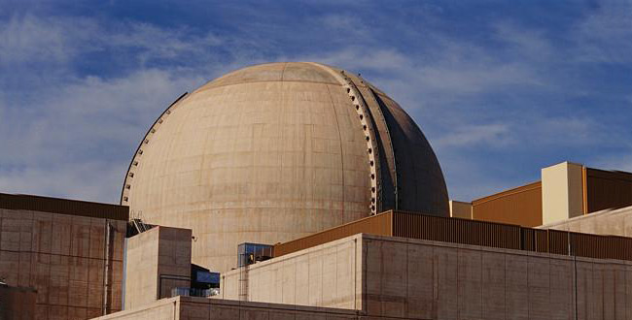
Nuclear Energy

Slide 2

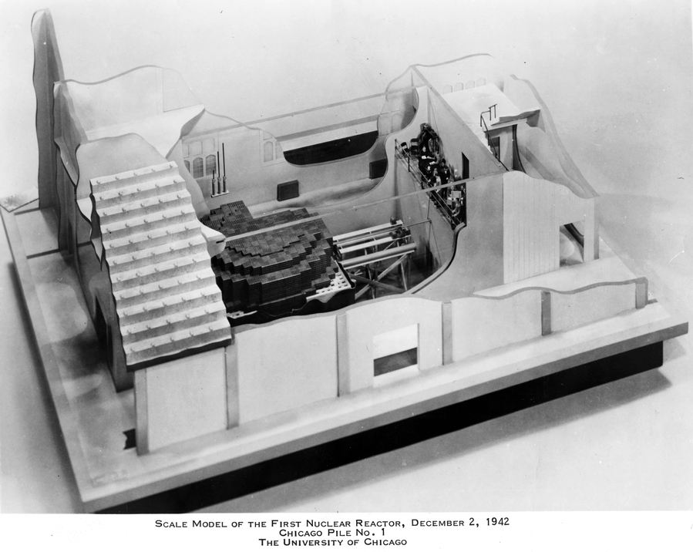
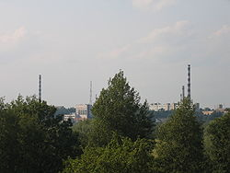
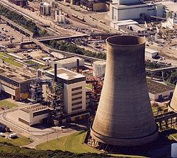
Nuclear Power - timelines
1933 - Concept of nuclear chain reaction – Hungarian Leo Szilard
1942 – First nuclear reactor built by Enrico Fermi – Chicago Pile-1
1954 – First civil nuclear reactor – AM-1 Obninsk Nuclear Power Plant (5MWe)
1956 – First “commercial” nuclear plant – Calder Hall, Sellafield (50 MWe, later 200 MWe)

Slide 3
Nuclear Power in the World
The first commercial nuclear power stations started operation in the 1950s
There are now some 430 commercial nuclear power reactors operating in 31 countries, with 372,000 MWe of total capacity
Mean age of reactors 27 years
They provide about 13.5% of the world's electricity as continuous, reliable base-load power, and their efficiency is increasing
56 countries operate a total of about 240 research reactors reactors
180 reactors power ships and submarines
EG5066 Energy Technologies: current issues & future directions

Slide 4
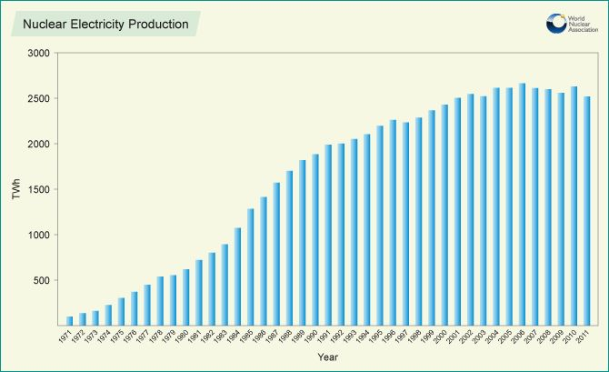
Nuclear Electricity Production
EG5066 Energy Technologies: current issues & future directions

Slide 5
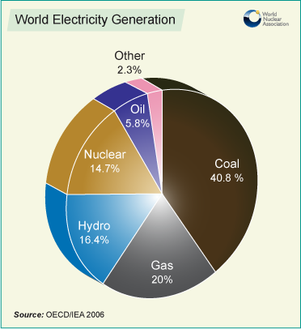
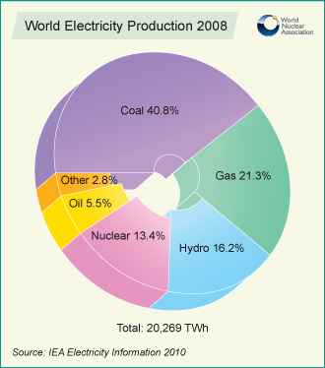
World Nuclear Electricity

Slide 6
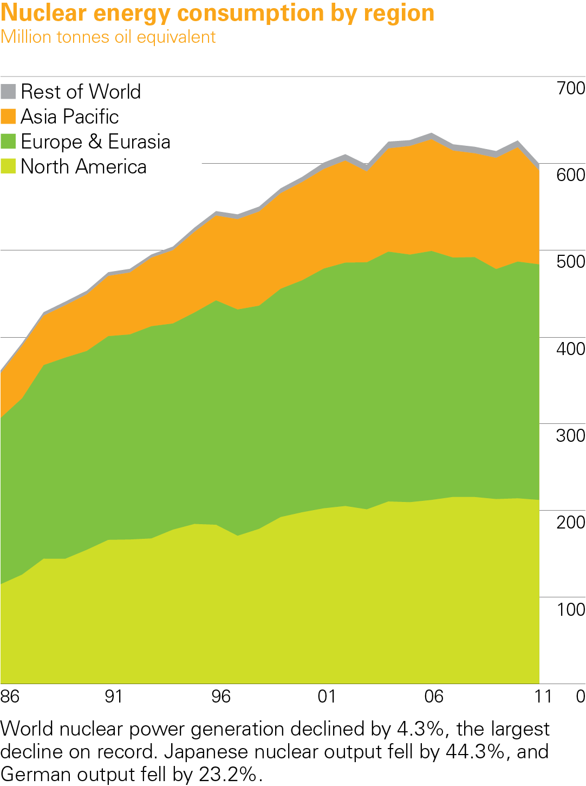
Nuclear energy consumption by region 2011
BP Statistical Review of World Energy 2012
© BP 2012

Slide 7
Nuclear Consumption (Mtoe)
 | 1965 | 1975 | 1985 | 1995 | 2005 | 2010
North America | 0.9 | 43.8 | 105.1 | 184.5 | 209.2 | 213.8
S & C America | - | 0.5 | 2.1 | 2.2 | 3.7 | 4.9
Europe & Eurasia | 4.9 | 32.6 | 181.1 | 243.7 | 286.3 | 272.9
Middle East | - | - | - | - | - | -
Africa | - | - | 1.3 | 2.7 | 2.9 | 3.1
Asia Pacific | - | 5.5 | 45.8 | 93.0 | 125.0 | 131.7
World | 5.8 | 82.4 | 335.3 | 526.1 | 627.2 | 626.3
Source: BP 2012

Slide 8
Nuclear Consumption (TWh)
 | 1970 | 1980 | 1990 | 2000 | 2010
North America | 23.0 | 300.1 | 682.6 | 874.1 | 945.0
S & C America | - | 2.3 | 9.5 | 12.2 | 21.6
Europe & Eurasia | 49.8 | 312.2 | 1013.0 | 1181.7 | 1205.9
Middle East | - | - | - | - | -
Africa | - | - | 8.9 | 13.7 | 13.5
Asia Pacific | 4.6 | 96.8 | 288.3 | 500.7 | 582.1
World | 77.3 | 711.4 | 2002.3 | 2582.4 | 2768.1
Source: BP 2012

Slide 9
Nuclear Consumption (Mtoe)
 | 1965 | 1975 | 1985 | 1995 | 2005 | 2010
USA | 0.9 | 41.1 | 91.4 | 160.4 | 185.9 | 192.2
France | 0.2 | 4.1 | 50.7 | 85.4 | 102.4 | 96.9
S Africa | - | - | 1.3 | 2.7 | 2.9 | 3.1
China | - | - | - | 2.9 | 11.8 | 16.7
India | - | 0.5 | 1.0 | 1.7 | 4.0 | 5.2
Japan | - | 4.9 | 34.4 | 65.1 | 66.3 | 66.2
S Korea | - | - | 3.8 | 12.7 | 33.2 | 33.6
Source: BP 2012

Slide 10
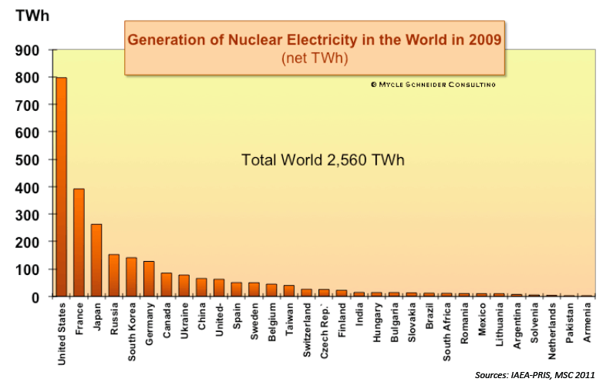
Nuclear Electricity Production

Slide 11
Nuclear
Big 6 countries provide 70% of generation
 | No Reactors | Capacity (Mwe) | Average age (y) | Share Electricity | Share Energy
France | 58 | 63130 | 27 | 78 | 41
Germany | 9 | 12068 | 27 | 18 | 8
Japan | 44 | 38120 | 25 | 18 | 8
Russia | 33 | 23643 | 29 | 18 | 6
S Korea | 21 | 18657 | 17 | 35 | 13
USA | 104 | 101465 | 33 | 19 | 8

Slide 12
World Nuclear Power September 2012
Production
(MWe)
Reactors
No
Operable
433
372,010
Under construction
65
64, 979
Planned
160
177,915
Proposed
323
366,415
Tonnes of Uranium required in 2012
67,990

Slide 13
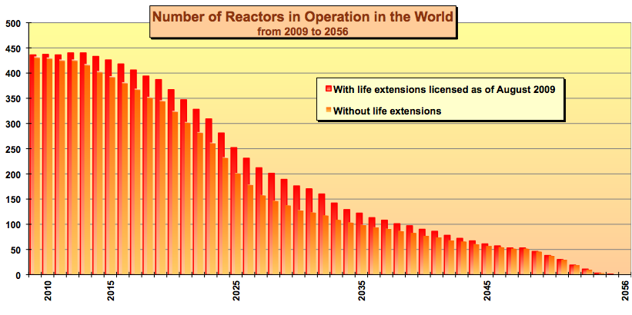
World Nuclear Power to 2056

Slide 14
Fission
When a relatively large fissile atomic nucleus (uranium-235, plutonium-239 or plutonium-241) absorbs a neutron it is likely to undergo nuclear fission
The original heavy nucleus splits into two or more lighter nuclei, releasing fission products:
Kinetic energy
Gamma radiation
Free neutrons
¹⁴¹Ba
²³⁵U
²³⁶U
⁹²Kr

Slide 15
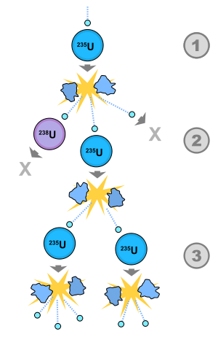
Chain reaction
Chain reaction controlled by:
Neutron poisons – e.g. control rods
Neutron moderators – e.g. heavy water
Cooling system
Removes heat from reactor core and used to produce heat of other useful work
Hot coolant used as heat source for a boiler and pressurised steam drives electrical generators

Slide 16
Common Components of Reactors
Fuel
Usually pellets of uranium oxide arranged in tubes to form fuel rods
Rods arranged into fuel assemblies in the reactor core
Moderator
Material in the core which slows neutrons released from fission
Usually water, sometimes heavy water or graphite
Control rods
Neutron absorbing material e.g. cadmium, hafnium, boron
Inserted or withdrawn from the core to control the rate of reaction or to halt it

Slide 17
Common Components of Reactors
Coolant
A liquid or gas circulating through the core to transfer heat from it
In light water reactors the water moderator functions also as primary coolant
Except in BWRs there is a secondary coolant circuit where the steam is made
Pressure vessel or pressure tubes
Usually a robust steel vessel containing the reactor core & moderator/coolant
May be a series of tubes holding the fuel and conveying the coolant through the moderator

Slide 18
Common Components of Reactors
Steam generator
Part of the cooling system where the primary coolant bringing heat from the reactor is used to make steam for the turbine
Containment
Structure around the reactor core designed to protect it from outside intrusion and protect those outside from effects of radiation in case of a malfunction
typically a metre-thick concrete and steel structure

Slide 19
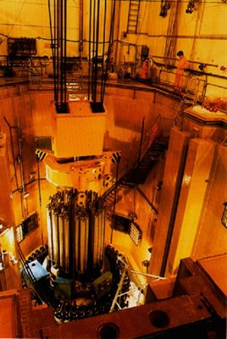
Fission
Nuclear chain reaction controlled by neutron poisons and neutron moderators:
Poisons:
Control rods
Boron
Moderators:
Light water (75% of world’s reactors)
Solid graphite (20% of reactors)
Heavy water (5%)

Slide 20
Types of Reactor
Pressurized water reactors (PWR)
Boiling Water Reactor (BWR)
Pressurized Heavy Water Reactor (PHWR)
Advanced Gas-cooled Reactor (AGR)
High Power Channel Reactor (RBMK)
Fast Neutron Reactor (FBR)

Slide 21
Types of Fission Reactor
Reactor | Fuel | Moderator | Coolant
PWR | Enriched Uranium | Light water | Light water
BWR | Enriched Uranium | Light water | Light water/steam
Magnox | Natural Uranium | Graphite | CO₂ gas
AGR | Enriched Uranium | Graphite | CO₂ gas
CANDU | Natural Uranium | Heavy water | Heavy water
RBMK | Enriched Uranium | Graphite | Light water/steam
LMFBR | Highly Enriched Uranium | None | Liquid sodium

Slide 22
Nuclear Power Plant in Commercial Operation (2008)
Reactor Type | Main Countries | Number | GWe | Fuel | Coolant | Moderator
Pressurised water reactor (PWR) | US, France, Japan, Russia, China | 265 | 251.6 | Enriched UO₂ | Water | Water
Boiling Water Reactor (BWR) | US, Japan, Sweden | 94 | 86.4 | Enriched UO₂ | Water | Water
Pressurised heavy water reactor “Candu” | Canada | 44 | 24.3 | Natural UO₂ | Heavy water | Heavy Water
Gas cooled reactor (AGR & Magnox) | UK | 18 | 10.8 | Natural U Enriched UO₂ | CO₂ | Graphite
Light water graphite reactor (RBMK) | Russia | 12 | 12.3 | Enriched UO₂ | Water | Graphite
Fast neutron reactor (FBR) | Japan, France, Russia | 4 | 1 | PuO₂ & UO₂ | Liquid Sodium | None

Slide 23
Reactor Type | Thermal Power (MW/m³) | Yield (%)
Magnox | 1 | 30
AGCR | 2 | 41
PWR, VVER | 100 | 33
BWR | 50 | 33
Candu | 12 | 29
FBR | 500 | 40
HTR* | 8 | >45
* High temperature reactor, a generation IV prototype
Source: Ngo & Natowitz, 2009

Slide 24
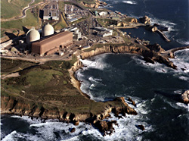
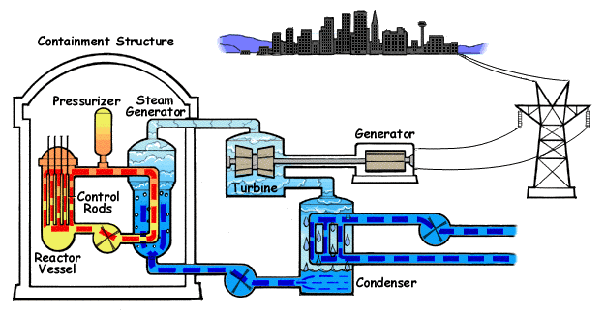
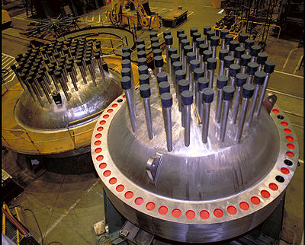
Pressurized Water Reactor
Main type of Light Water Reactor
In contrast to boiling water reactor the primary coolant loop is superheated water under high pressure
Use ordinary light water as both coolant & moderator
Diablo Canyon Power Plant
PWR Reactor Vessel heads

Slide 25
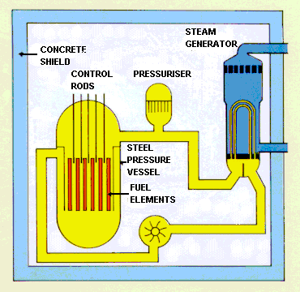
Pressurised Water Reactors (PWRs)
Based on US technology
Most common reactor type used in the world
Reactor is contained in a steel pressure vessel
Pressurised water (moderator & coolant) pumped around reactor & through boilers
Pressure vessel, boilers and connecting pipe-work form a sealed primary pressurised circuit, which is contained within a steel-lined pre-stressed concrete containment building, which also acts as a biological shield.
Remainder of the generation process is similar to that for other power stations.
Source: DECC

Slide 26
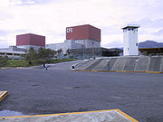
Boiling Water Reactor
2nd most common reactor
Ordinary water used as moderator & coolant
Operates at low pressure which allows water to boil
No separate secondary steam cycle
Water from reactor converted to steam & used to directly drive the generator turbine
Laguna Verde Nuclear power plant, Mexico

Slide 27
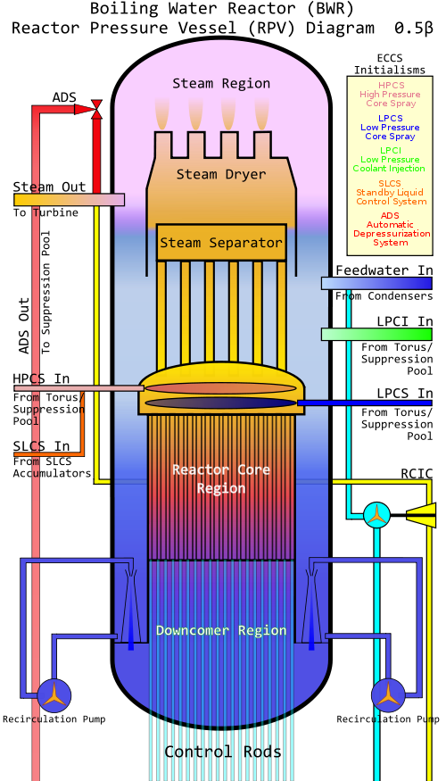
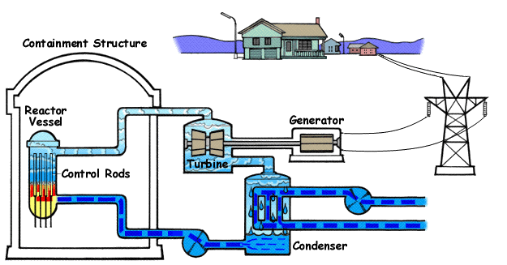
Boiling Water Reactor

Slide 28
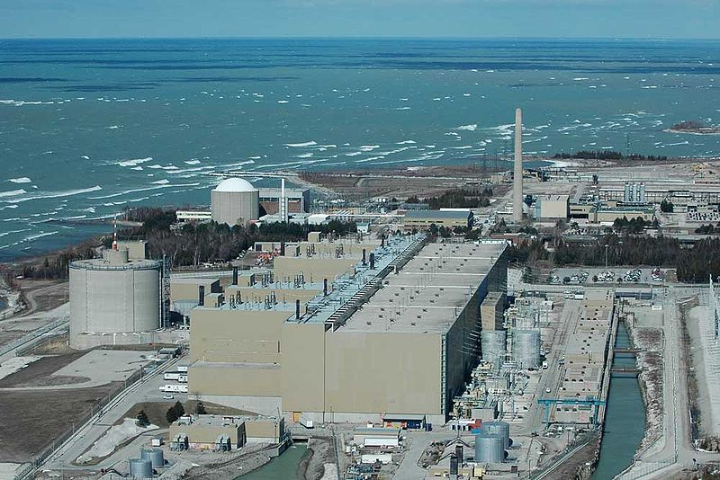
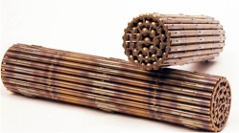
Pressurized Heavy Water Reactors (PHWR)
CANDU Reactor
Canadian invented pressurized heavy water reactor late 1950s & 1960s
CANada Deuterium Uranium – deuterium-oxide (heavy water) moderator and Uranium
Fuel bundles
CANDU Bruce Nuclear Reactor
Second largest plant in the world.

Slide 29
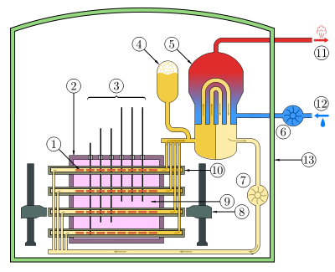
CANDU Reactor
1 - Fuel bundle
2 - Calandria (reactor core)
5 - Steam generator
9 - Heavy water moderator

Slide 30
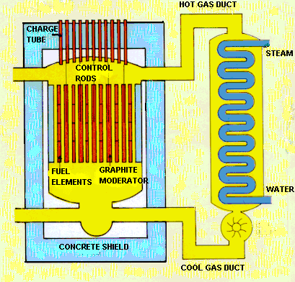
Magnox Reactors
The first commercial nuclear stations in the UK
Named after the magnesium alloy used to make the fuel can containing the uranium fuel
Use natural uranium metal as the fuel
Graphite moderator
Pressurised CO₂ as the coolant
Source: DECC

Slide 31
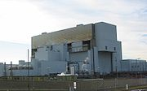
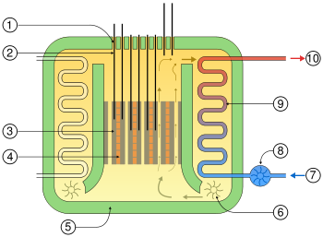
Advanced gas-cooled reactor (AGR)
2nd generation of British gas-cooled reactors – developed from Magnox
Uses graphite as the neutron moderator and CO₂ as coolant
Configured with 2 reactors in single building
Torness
1. Charge tubes 2. Control rods 3. Graphite moderator 4. Fuel assemblies 5. Concrete pressure vessel & radiation shielding 6. Gas circulator 7. Water 8. Water circulator 9. Heat exchanger 10. Steam

Slide 32
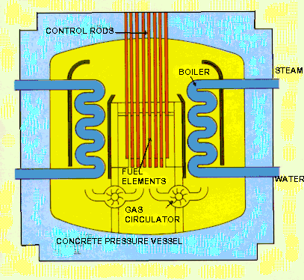
Advanced gas-cooled reactor (AGR)
Successor to the Magnox reactors & unique to the UK
Use enriched uranium clad stainless steel cans
Also have a graphite moderator and use pressurised CO₂ as the coolant.
These allow the AGRs to operate at a higher temperature than the Magnox reactor.
Reactor is encased in a steel-lined pre-stressed concrete pressure vessel several metres thick which acts as the biological shield, with the boilers inside.
Coolant conveys heat from the reactor to the boilers which, in turn, heats water in an isolated steam circuit which is then used to turn the turbines.
Source: DECC

Slide 33
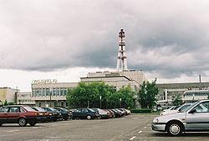
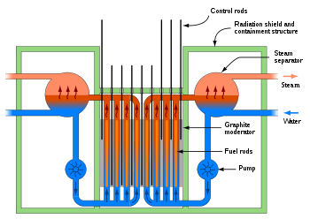
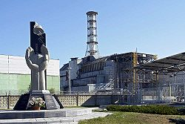
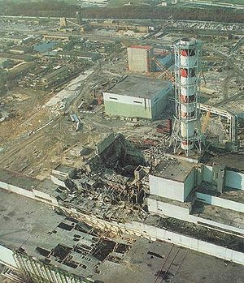
RBMK Reactors
Russian High Power Channel Type Reactor
Class of graphite-moderated nuclear power reactor
Type involved in Chernobyl accident
Uses light water for cooling and graphite for moderation
Uses natural uranium for fuel
Ignalina Nuclear Power Plant, Lithuania
Chernobyl

Slide 34
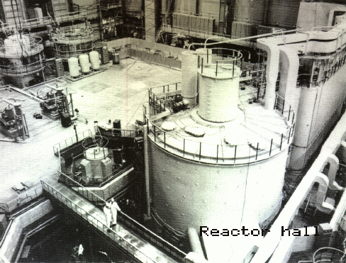
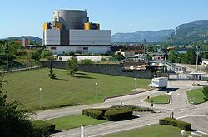
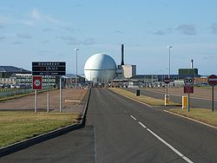
Fast Neutron Reactor
Fission chain reaction sustained by fast neutrons
Needs no neutron moderator
Needs fuel rich in fissile material
All current fast reactors are liquid metal cooled (lead or sodium)
Fuel – enriched uranium or plutonium
Shevchenko BN350 nuclear-heated desalination plant
Superphenix power plant, France
Dounreay

Slide 35
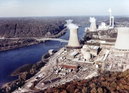
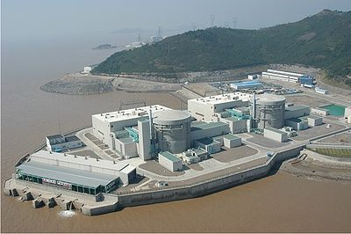
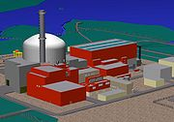
Generations of Nuclear Plants
Gen IV
Generation I
Generation II
Generation III
Generation III+
Early prototype
reactors
Commercial power
reactors
Advanced
LWRs
Near-term
deployment
Economic
Safe
Min waste
Shippingport
Dresden
Fermi
Magnox
ABWR
System 80+
AP600
EPR
Evolutionary designs with improved economics
LWR-PWR, BWR
CANDU
WER/RBMK
Gen IV
Generation I
Generation II
Generation III
Generation III+
1950
1960
1970
1980
1990
2000
2010
2020
2030

Slide 36
Generation IV Nuclear Energy Systems
Very High Temperature Reactor (VHTR)
Super Critical Water Cooled Reactor (SCWCR)
Gas Cooled Fast Reactor (GCFR)
Lead Cooled Fast Reactor (LCFR)
Sodium Cooled Fast Reactor (SCFR)
Molten Salt Reactor (MSR)

Slide 37
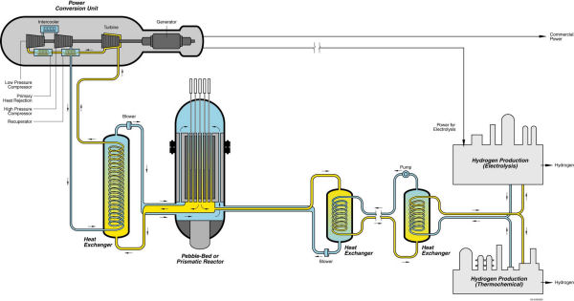
Very-High-Temperature Reactor (VHTR)
Graphite-moderated
Helium-cooled
Once-through uranium fuel cycle.
Supplies heat with high core outlet temperatures which enables applications such as hydrogen production or process heat for the petrochemical industry or others
Source: Idaho National Laboratory

Slide 38
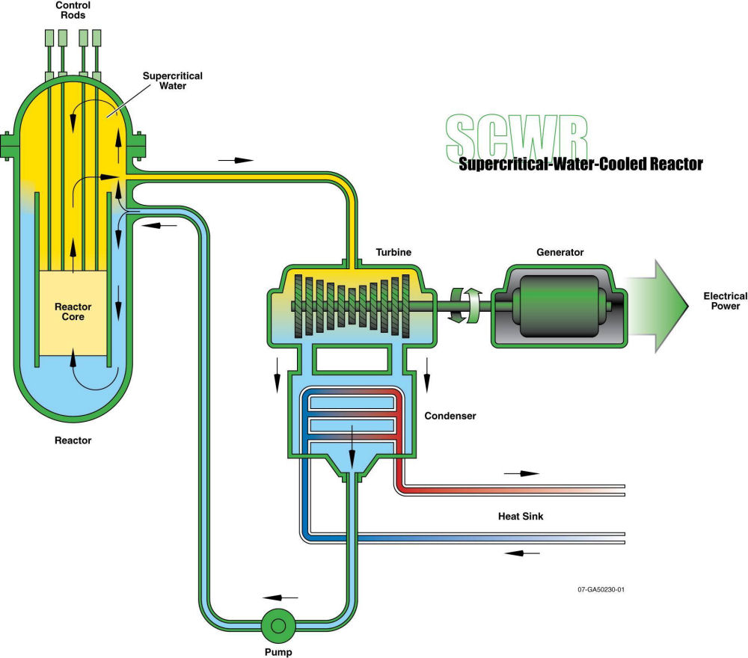
Supercritical-Water-Cooled Reactor (SCWR)
High-temperature, high-pressure water cooled reactor that operates above the thermodynamic critical point of water (374Â°C, 22 MPa)
Built upon two proven technologies:
Light Water Reactors (LWRs)
Supercritical fossil-fired boilers
Source: Idaho National Laboratory

Slide 39
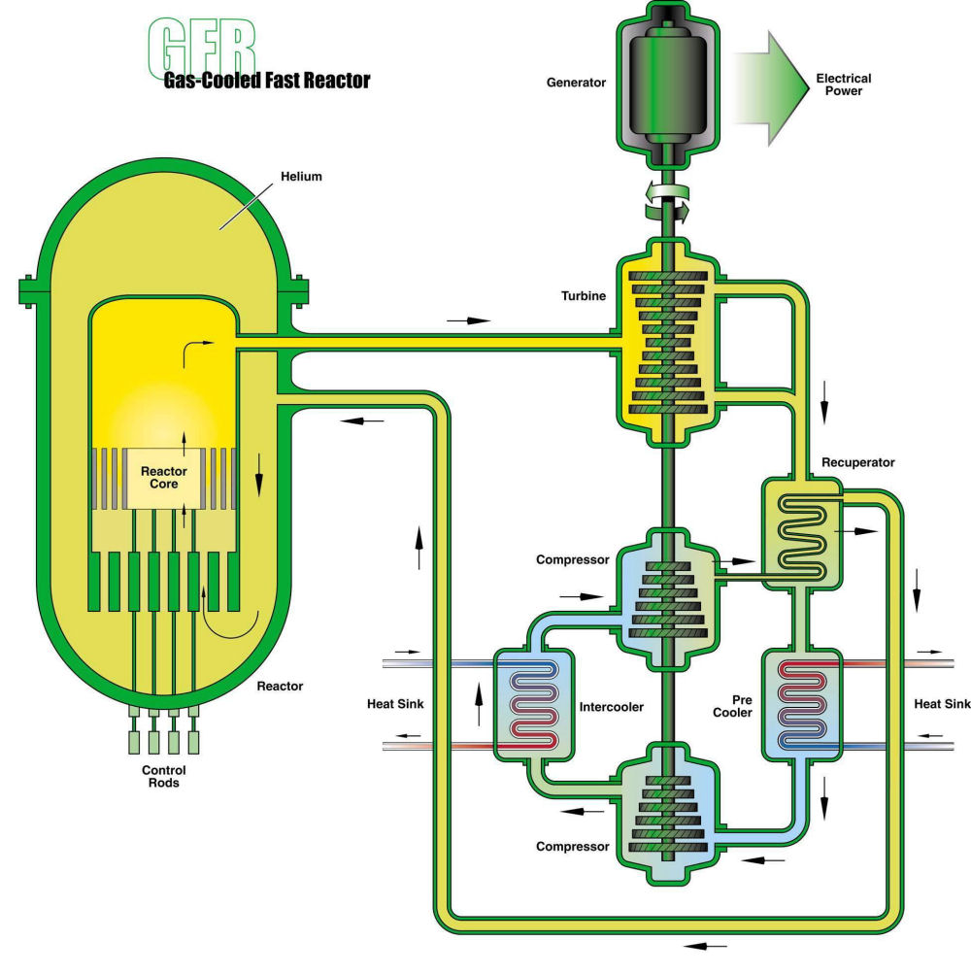
Gas-Cooled Fast Reactor (GFR)
Features a fast-spectrum, helium-cooled reactor and closed fuel cycle.
Main characteristics:
a self-generating core (i.e., conversion ratio = 1) with a fast neutron spectrum
robust refractory fuel
high operating temperature
direct energy conversion with a gas turbine
full actinide recycling
Source: Idaho National Laboratory

Slide 40
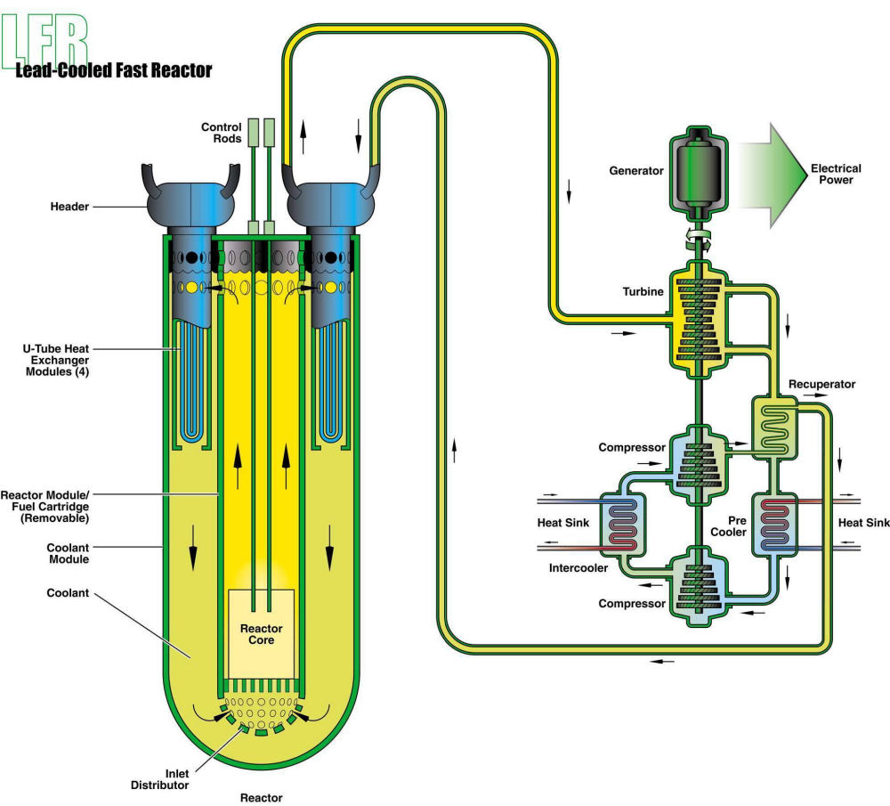
Lead-Cooled Fast Reactor (LFR)
Features a fast-spectrum lead or lead/bismuth eutectic liquid metal-cooled reactor and a closed fuel cycle for efficient conversion of fertile uranium and management of actinides.
Source: Idaho National Laboratory

Slide 41
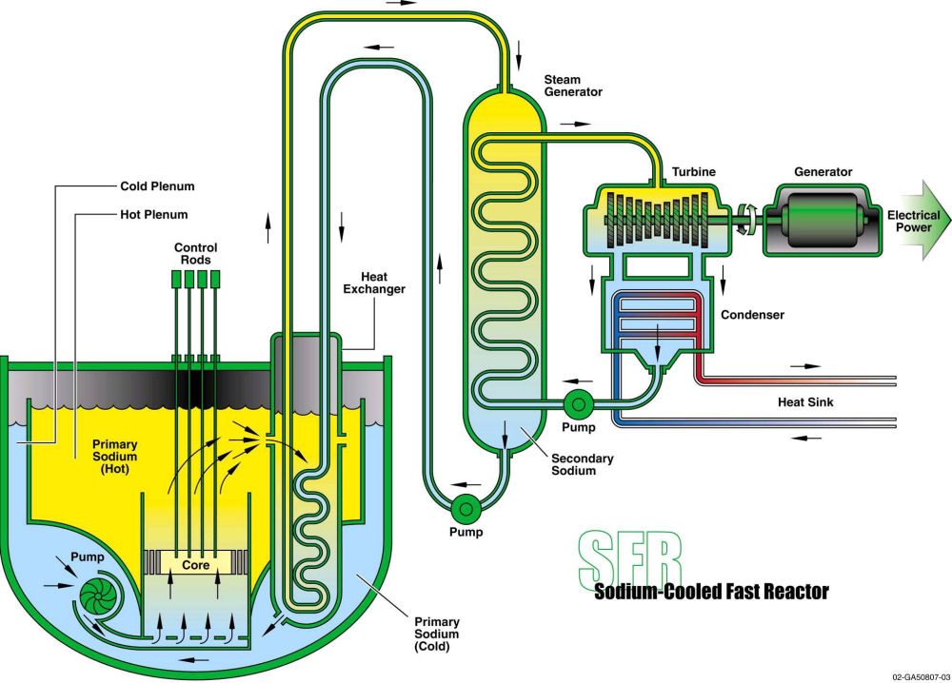
Sodium-Cooled Fast Reactor (SFR)
Features a fast-spectrum, sodium-cooled reactor and a closed fuel cycle for efficient management of actinides and conversion of fertile uranium.
Source: Idaho National Laboratory

Slide 42
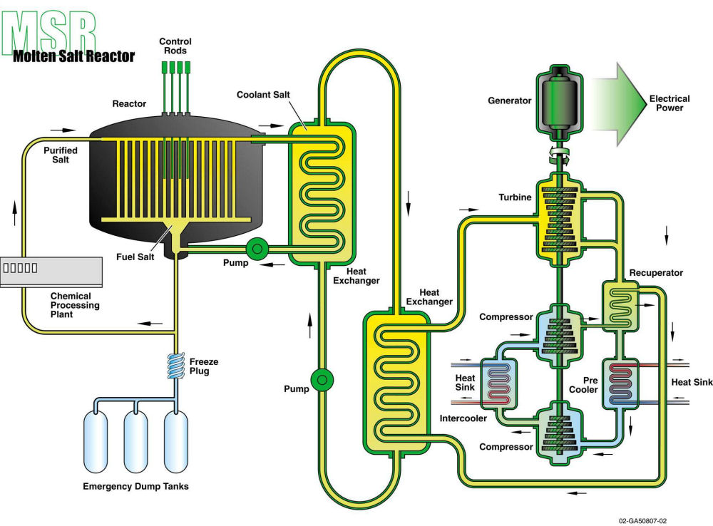
Molten Salt Reactors (MSRs)
Liquid-fueled reactors that can be used for production of electricity, actinide burning, production of hydrogen, and production of fissile fuels.
Source: Idaho National Laboratory

Slide 43
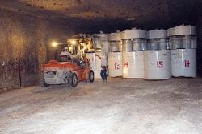
Issues for Nuclear Power
Safety
Weapons proliferation/terrorism
Windscale , UK 1957
Three Mile Island, USA, 1979
Chernobyl, Ukraine, 1986
Fukushima-Daiichi, Japan, 2011
Wastes
Need to find long-term storage solution that satisfies concerns of public
Costs
More expensive than gas-fired power stations
Not “too cheap to meter”
Increasing in response to concerns over safety
Availability of Uranium
Is there more than 50 years supply left?

Slide 44
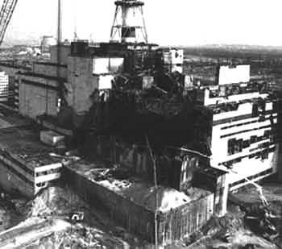
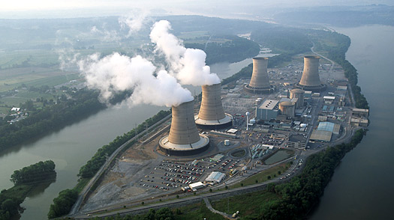
Issues for Nuclear Power
Safety
Windscale , UK 1957 - fire at plutonium production pile releases 1000TBq of radioactive iodine
Three Mile Island, USA, 1979 – loss of coolant, partial meltdown of the fuel in the reactor core
Windscale Fire
Three Mile Island

Slide 45
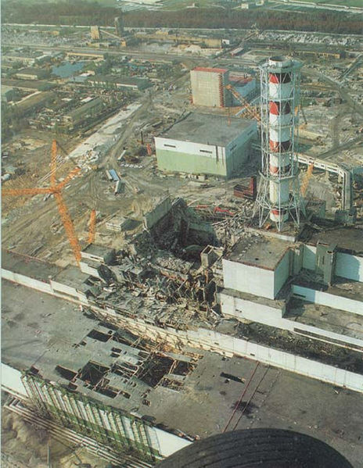
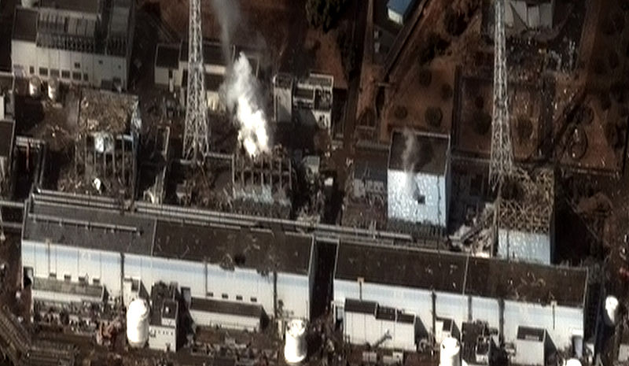
Issues for Nuclear Power
Safety
Chernobyl, Ukraine, 1986
Fukushima-Daiichi, Japan, 2011
Fukushima Daiichi Nuclear Disaster
Chernobyl after the disaster

Slide 46
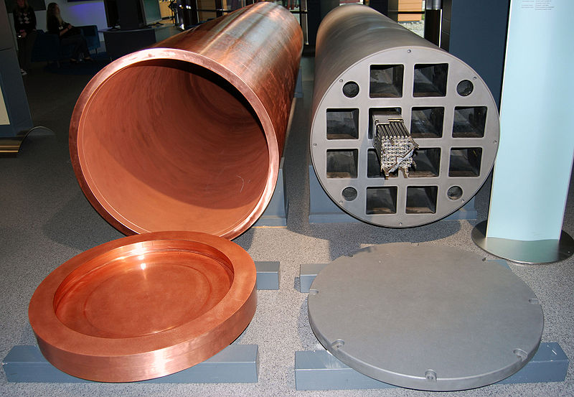
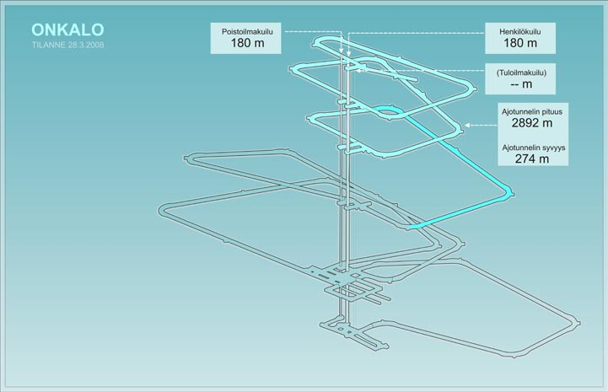
Issues for Nuclear Power
Wastes
Need to find long-term storage solution that satisfies concerns of public
Swedish KBS-3 capsule for nuclear waste
Geologic Depository at Olkiluoto Nuclear Power Plant in Finland

Slide 47
Known Recoverable Resources of Uranium
Uranium is abundant in the earth’s crust as tin or zinc
Uranium occurs in many kinds of chemical compounds, minerals & rocks
Uranium ore is an uranium containing deposit from which uranium can be extracted economically
Known amount of ore depends on market prices
Known recoverable = RAR + EAR
RAR = Reasonable Assured Resources
EAR = Estimated Additional Resources
Figures on next slide based on 130US$/kgU
Current Fleet is 372 GW which uses 6800 tonnes uranium per annum
Estimates indicate that exploitable reserves of uranium will have been depleted by 2070

Slide 48
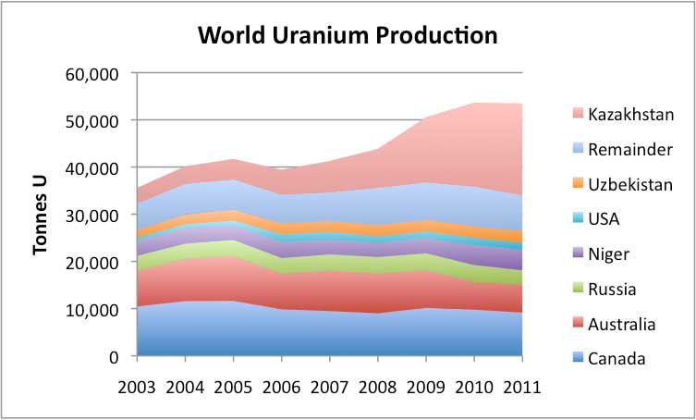
Resources of Uranium

Slide 49

Resources of Uranium

Slide 50

Resources of Uranium

Slide 51
Known Recoverable Resources of Uranium 2011
Country | K tonnes | %
Australia | 1,661 | 31
Kazakhstan | 629 | 12
Russia | 487 | 9
Canada | 469 | 9
Niger | 421 | 8
South Africa | 279 | 5
Nambia | 261 | 5
Brazil | 263 | 5
USA | 207 | 4
China | 166 | 3
Ukraine | 120 | 2
Uzbekistan | 96 | 2
World | 5327

Slide 52



Nuclear fusion
Fusion power offers the prospect of an almost inexhaustible source of energy for future generations, but it also presents so far insurmountable scientific and engineering challenges.
The main hope is centred on tokamak reactors which confine a deuterium-tritium plasma magnetically.

Slide 53

Thorium Cycle
Naturally occurring, slightly radioactive metal discovered in 1828 by Swedish chemist Jons Jakob Berzelius
3 times more abundant than uranium
Mainly obtained from monazite sands (a rare earth phosphate mineral)
Single isotope – ²³²Th
In reactor captures a neutron and converted to ²³³U
²³³U undergoes fission like ²³⁵U and ²³⁹Pu but releases more neutrons
Amount of transuranic waste vastly decreased cf uranium/plutonium-based reactors
Used in India’s nuclear programme
Have 25% of world’s thorium reserves
Kakrapar-1 first thorium reactor
Developing a 3 stage thorium fuel cycle
Developing a 300MWe thorium-based Advanced Heavy Water Reactor (AHWR)

Slide 54
Thorium
Advantages
An abundant resource
Production of power with few long-lived transuranic elements in the waste
Reduced radioactive wastes generally
Problems
High cost of fuel fabrication, due partly to the high radioactivity of ²³³U chemically separated from the irradiated thorium fuel
Similar problems in recycling thorium due to highly radioactive ²²⁸Th (an alpha emitter with a 2 year half life) present
Concern over weapons proliferation risk of ²³³U
Technical problems in reprocessing solid fuels but may disappear with development of molten salt reactor (MSR)
Long-lived actinides produced that constitute a long-term radiological impact (eg ²³¹Pa)

Slide 55
Thorium
Country | Reserves (k tonnes) | Percentage
India | 846 | 16
Turkey | 744 | 14
Brazil | 606 | 11
Australia | 521 | 10
USA | 434 | 8
Egypt | 380 | 7
Norway | 320 | 6
Venezuela | 300 | 6
World | 5385
Source: NEA 2011

Slide 56
Nuclear Power in the UK
The UK has 16 reactors at 9 plants generating 16% of its electricity and all but 2 will be retired by 2023
14 AGRs, 1 Magnox & 1 PWR operating
At peak in 1997 generated 26% of electricity
First commercial nuclear power reactor in 1956
Has full fuel cycling facilities, including major reprocessing plants
UK Government commitment to the future of nuclear energy is firm
New generation plants expected to be on line about 2017?
Scottish Government is strongly anti-nuclear
EG5066 Energy Technologies: current issues & future directions

Slide 57
Nuclear Power Reactors Operating in UK
Reactor | Operator | Type | Net Capacity | Start | Shutdown
Wylfa 1&2 | Magnox | Magnox | 980 | 1972 | End 2012
Dungeness B 1&2 | EDF | AGR | 1110 | 1985 | 2018
Hartlepool 1&2 | EDF | AGR | 1210 | 1989 | 2019
Heysham 1 | EDF | AGR | 1150 | 1989 | 2019
Heysham 2 | EDF | AGR | 1250 | 1989 | 2023
Hinkley Point B 1&2 | EDF | AGR | 1220 | 1976 | 2016
Hunterson B | EDF | AGR | 1190 | 1976 | 2016
Torness 1&2 | EDF | AGR | 1250 | 1988 | 2023
Sizewell B | EDF | PWR | 1188 | 1995 | 2035

Slide 58
Nuclear Power Reactors Retired in UK
Power Station | Type | Net MWe | Start | Close
Calder Hall | Magnox | 200 | 1959 | 2003
Chapelcross | Magnox | 240 | 1960 | 2004
Berkeley | Magnox | 276 | 1962 | 2004
Bradwell | Magnox | 246 | 1962 | 1989
Hunterston A | Magnox | 300 | 1964 | 1990
Hinkley Point A | Magnox | 470 | 1965 | 2000
Trawsfynydd | Magnox | 390 | 1965 | 1991
Dungeness A | Magnox | 450 | 1965 | 2006
Sizewell A | Magnox | 420 | 1966 | 2006
Oldbury | Magnox | 434 | 1968 | 2012

Slide 59

Future of Nuclear Power in UK
November 2009 UK government identified 10 nuclear sites for future reactors, reduced to 8 in 2010:
Bradwell in Essex
Sellafield in Cumbria
Hartlepool ion County Durham
Heysham in Lancashire
Hinkley Point in Somerset
Oldbury in Gloucestershire
Sizewell in Suffolk
Wyfla in North Wales

Slide 60
EG5066 Energy Technologies: current issues & future directions

